Slide 1

JavaScript, Sixth Edition
Chapter 8
Manipulating Data in Strings and Arrays

Slide 2
Objectives
When you complete this chapter, you will be able to:
Manipulate strings with properties and methods of the String object
Create regular expressions and use them to validate user input
Manipulate arrays with properties and methods of the Array object
Convert between strings and arrays, and between strings and JSON
JavaScript, Sixth Edition

Slide 3
Manipulating Strings
String
  Text contained within double or single quotation marks
  Literal values or assigned to a variable
  Begin and end with same type of quotation mark
Example:
document.getElementById("mainHeading").innerHTML = "24-Hour↵
^{Forecast";}
var highSurfAdvisory = "Watch out for high waves and strong↵
^{rip currents.";}
JavaScript, Sixth Edition

Slide 4
Manipulating Strings (cont’d.)
Parsing
  Extracting characters or substrings from a larger string
Use String class to parse text strings in scripts
    Represents all literal strings and string variables in JavaScript
  Contains methods for manipulating text strings
JavaScript, Sixth Edition

Slide 5
Formatting Strings
Using special characters
  For basic types: use escape sequences
  var mainHead = 'Today\'s Forecast';
  For other special characters: use Unicode
    Standardized set of characters from many of the world’s languages
copyrightInfo = "<p>&#169; 2006-2017</p>";
^{// numeric character ref.}
copyrightInfo = "<p>&copy; 2006-2017</p>";
^{// character entity}
JavaScript, Sixth Edition

Slide 6
Formatting Strings (cont’d.)
Using special characters (cont’d.)
  fromCharCode() method
    Constructs a text string from Unicode character codes
  Syntax:
    String.fromCharCode(char1, char2, ...)
  Examples:
String.fromCharCode(74,97,118,97,83,99,114,105,112,116)
copyrightInfo = String.fromCharCode(169) + " 2017";
JavaScript, Sixth Edition

Slide 7
Formatting Strings (cont’d.)
Changing case
  toLowerCase() and toUpperCase() methods
  Examples:
^{var agency = "noaa";}
agencyName.innerHTML = agency.toUpperCase();
// browser displays "NOAA" but value of agency is still "noaa"
^{var agency = "noaa";}
^{agency = agency.toUpperCase();}
^{// value of agency is "NOAA"}
^{agencyName.innerHTML = agency;}
^{// browser displays "NOAA"}
JavaScript, Sixth Edition

Slide 8
Counting Characters in a String
length property
  Returns the number of characters in a string
  Example:
var country = "Kingdom of Morocco";
var stringLength = country.length;
^{// value of stringLength is 18}
JavaScript, Sixth Edition

Slide 9
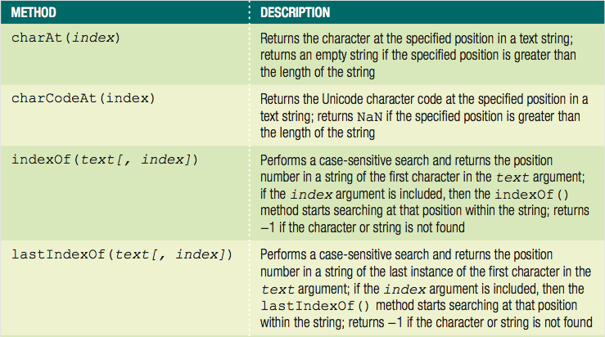
Finding and Extracting Characters and Substrings
Table 8-1 Search and extraction methods of the String class (continues)
JavaScript, Sixth Edition

Slide 10
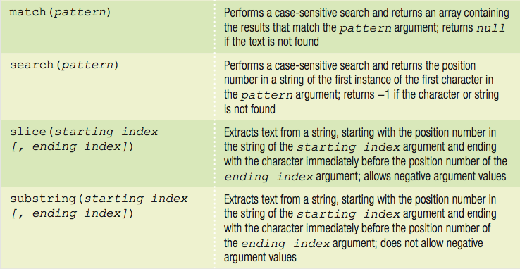
Finding and Extracting Characters and Substrings (cont’d.)
Table 8-1 Search and extraction methods of the String class
JavaScript, Sixth Edition

Slide 11
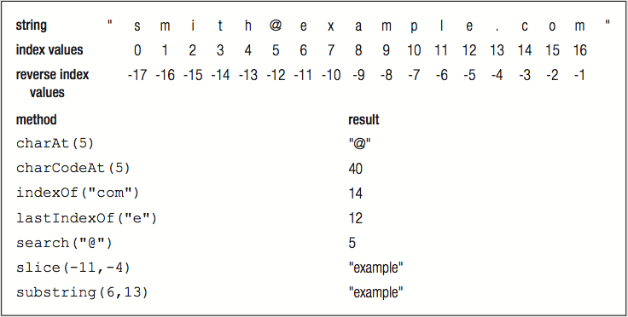
Finding and Extracting Characters and Substrings (cont’d.)
Figure 8-5 Example uses of String class methods
JavaScript, Sixth Edition

Slide 12
Finding and Extracting Characters and Substrings (cont’d.)
Two types of string search methods
  Those that return a numeric position in a text string
    Character position in text string begins with a value of zero
    Can pass a second optional argument specifying the position in the string to start searching to the indexOf() method
    Example: search() method
      var email = "president@whitehouse.gov";
      var atPosition = email.search("@"); // returns 9
JavaScript, Sixth Edition

Slide 13
Finding and Extracting Characters and Substrings (cont’d.)
Two types of string search methods (cont'd.)
  Those that return a numeric position in a text string (cont'd.)
    Example: indexOf() method
      var email = "president@whitehouse.gov";
      var atIndex = email.indexOf("@", 10); // returns -1
JavaScript, Sixth Edition

Slide 14
Finding and Extracting Characters and Substrings (cont’d.)
Two types of string search methods (cont’d.)
  Those that return a character or substring
    substring() or slice() method
var email = "president@whitehouse.gov";
var nameEnd = email.search("@");
^{// value of nameEnd is 9}
var nameText = email.substring(0, nameEnd);
// value of nameText is "president"
JavaScript, Sixth Edition

Slide 15
Finding and Extracting Characters and Substrings (cont’d.)
Extracting characters from the middle or end of a string
  Use the search(), indexOf(), lastIndexOf() methods
    lastIndexOf() method returns position of the last occurrence of one string in another string
  Example:
var email = "president@whitehouse.gov";
var startDomainID = email.lastIndexOf(".");
^{// startDomainID value is 20}
var domainID = email.substring(startDomainID + 1);
^{// domainID value is "gov"}
JavaScript, Sixth Edition

Slide 16
Finding and Extracting Characters and Substrings (cont’d.)
slice() method allows negative argument values for the index arguments
  Specifying a negative value for the starting index
    slice() method starts at the end of the text string
  Specifying a negative value for the ending index
    Number of characters the slice() method extracts also starts at the end of the text string
slice() method does not return the character represented by the ending index
  Returns the character immediately before the ending index
JavaScript, Sixth Edition

Slide 17
Finding and Extracting Characters and Substrings (cont’d.)
var email = "president@whitehouse.gov";
var nameText = email.slice(0,9);
// nameText value is "president"
var domain = email.slice(-14,-4);
// domain value is "whitehouse"
JavaScript, Sixth Edition

Slide 18
Replacing Characters and Substrings
replace() method
  Creates a new string with the first instance of a specified pattern replaced with the value of the text argument
  Syntax: string.replace(pattern, text)
  Example:
var email = "president@whitehouse.gov";
var newEmail = email.replace("president", "vice.president");
// value of newEmail is "vice.president@whitehouse.gov"
JavaScript, Sixth Edition

Slide 19
Combining Characters and Substrings
Combining strings
  Use the concatenation operator (+) and compound assignment operator (+=)
  Use the concat() method
    Creates a new string by combining strings passed as arguments
    Syntax: string.concat(value1, value2, ...)
  To combine text strings
    Easier to use the concatenation operator and the compound assignment operator
JavaScript, Sixth Edition

Slide 20
Combining Characters and Substrings (cont’d.)
var name = "Theodor Seuss Geisel";
^{var penName = "Dr. Seuss";}
var bio = penName.concat(" was the pen name of ", name);
^{// value of bio is}
// "Dr. Seuss was the pen name of Theodor Seuss Geisel"
var name = "Theodor Seuss Geisel";
^{var penName = "Dr. Seuss";}
var bio = penName + " was the pen name of " + name;
^{// value of bio is}
// "Dr. Seuss was the pen name of Theodor Seuss Geisel"
JavaScript, Sixth Edition

Slide 21
Comparing Strings
Comparison operator (===) can be used with strings
  Compare individual characters according to their Unicode position
localeCompare() method
  Compares strings according to the particular sort order of a language or country
  Performs a case-sensitive comparison of two strings
JavaScript, Sixth Edition

Slide 22
Working with Regular Expressions
Regular expressions
  Patterns used for matching and manipulating strings according to specified rules
  With scripting languages, most commonly used for validating submitted form data
JavaScript, Sixth Edition

Slide 23
Defining Regular Expressions in JavaScript
Regular expressions
  Must begin and end with forward slashes
  Example: ^{var urlProtocol = /https/;}
Approaches to creating regular expressions
  Use regular expressions with several String class methods
  Pass pattern directly to a method
  Use the RegExp() constructor
    Contains methods and properties for working with regular expressions in JavaScript
JavaScript, Sixth Edition

Slide 24
Defining Regular Expressions in JavaScript (cont’d.)
Approaches to creating regular expressions (cont’d.)
  Syntax for creating a regular expression with the RegExp() constructor
    var regExpName = new RegExp("pattern"[, attributes]);
  Example:
    var urlProtocol = new RegExp("https");
    var url = "http://www.cengagebrain.com";
    var searchResult = url.search(urlProtocol);
    ^{// returns -1}
JavaScript, Sixth Edition

Slide 25
Using Regular Expression Methods
RegExp object
  Includes two methods
    test() and exec()
test() method: returns a value of true
  If a string contains text that matches a regular expression
  Otherwise returns false value
  Syntax: ^{var pattern = test(string);}
Real power of regular expressions
  Comes from the patterns written
JavaScript, Sixth Edition

Slide 26
Writing Regular Expression Patterns
Hardest part of working with regular expressions
  Writing the patterns and rules
  Example:
var emailPattern = /^[_a-zA-Z0-9\\-]+(\.[_a-zA-Z0-9\\-]+)*↵
@[a-zA-Z0-9\\-]+(\.[a-zA-Z0-9\\-]+)*(\.[a-z]{2,6})$/;
var email = "president@whitehouse.gov";
^{var result;}
if (emailPattern.test(email)) {
^{result = true;}
^{} else {}
^{result = false;}
}
^{// value of result is true}
JavaScript, Sixth Edition

Slide 27
Writing Regular Expression Patterns (cont’d.)
Regular expression patterns consist of literal characters and metacharacters
  Metacharacters: special characters that define the pattern matching rules in a regular expression
JavaScript, Sixth Edition

Slide 28
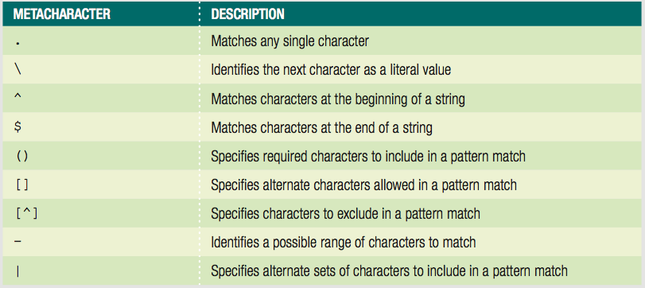
Writing Regular Expression Patterns (cont’d.)
Table 8-2 JavaScript regular expression metacharacters
JavaScript, Sixth Edition

Slide 29
Writing Regular Expression Patterns (cont’d.)
Matching any character
  Period (.)
    Matches any single character in a pattern
    Specifies that the pattern must contain a value where the period located
Matching characters at the beginning or end of a string
  ^ metacharacter
    Matches characters at the beginning of a string
  $ metacharacter
    Matches characters at the end of a string
JavaScript, Sixth Edition

Slide 30
Writing Regular Expression Patterns (cont’d.)
Matching characters at the beginning or end of a String (cont’d.)
  Anchor
    Pattern that matches the beginning or end of a line
  Specifying an anchor at the beginning of a line
    Pattern must begin with the ^ metacharacter
Matching special characters
  Precede the character with a backslash
JavaScript, Sixth Edition

Slide 31
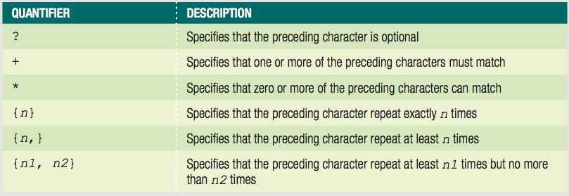
Writing Regular Expression Patterns (cont’d.)
Specifying quantity
  Quantifiers
    Metacharacters that specify the quantity of a match
Table 8-3 JavaScript regular expression quantifiers
JavaScript, Sixth Edition

Slide 32
Writing Regular Expression Patterns (cont’d.)
Specifying subexpressions
  Subexpression or subpattern
    Characters contained in a set of parentheses within a regular expression
    Allows determination of the format and quantities of the enclosed characters as a group
JavaScript, Sixth Edition

Slide 33
Writing Regular Expression Patterns (cont’d.)
Defining character classes
  Character classes
    Used in regular expressions to treat multiple characters as a single item
    Created by enclosing the characters that make up the class with bracket [] metacharacters
  Use a hyphen metacharacter (-) to specify a range of values in a character class
  To specify optional characters to exclude in a pattern match
    Include the ^ metacharacter immediately before the characters in a character class
JavaScript, Sixth Edition

Slide 34
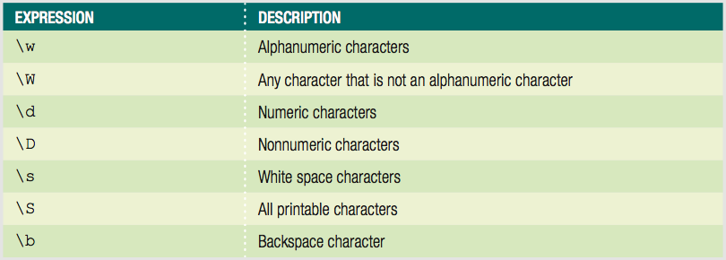
Writing Regular Expression Patterns (cont’d.)
Defining character classes (cont’d.)
  Regular expressions include special escape characters in character classes
    To represent different types of data
Table 8-4 JavaScript character class expressions
JavaScript, Sixth Edition

Slide 35
Writing Regular Expression Patterns (cont’d.)
Defining character classes (cont’d.)
  Matching multiple pattern choices
  Allow a string to contain an alternate set of substrings
    Separate the strings in a regular expression pattern with the | metacharacter
JavaScript, Sixth Edition

Slide 36
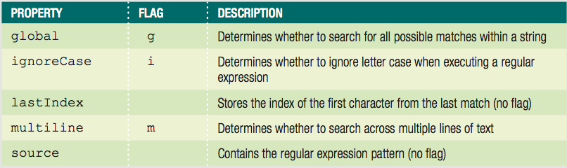
Setting Regular Expression Properties
Table 8-5 Properties of the RegExp object
JavaScript, Sixth Edition

Slide 37
Setting Regular Expression Properties (cont’d.)
Options for setting the values of these properties
  Assign a value of true or false to the property
    By creating a regular expression with the RegExp() constructor
  Use the flags when assigning a regular expression to a variable without using the RegExp() constructor
JavaScript, Sixth Edition

Slide 38
Manipulating Arrays
Use the Array class length property and methods
Creating an array
  Instantiates an object from the Array class
JavaScript, Sixth Edition

Slide 39
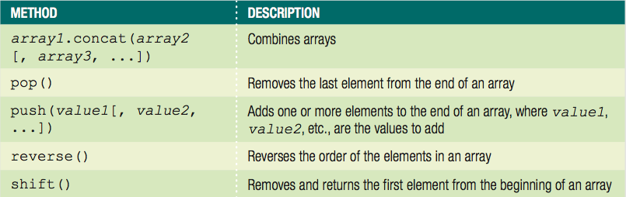
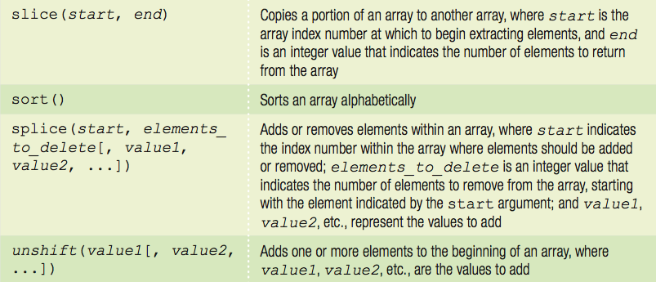
Manipulating Arrays (cont'd.)
Table 8-6 Methods of the Array class
JavaScript, Sixth Edition

Slide 40
Finding and Extracting Elements and Values
Primary method for finding a value in an array
  Use a looping statement to iterate through the array until a particular value found
Extract elements and values from an array
  Use the slice() method to return (copy) a portion of an array and assign it to another array
Syntax for the slice() method
  array_name.slice(start, end);
JavaScript, Sixth Edition

Slide 41
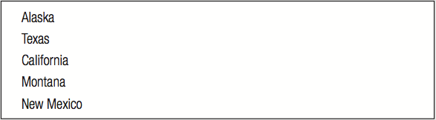
Finding and Extracting Elements and Values (cont’d.)
var largestStates = ["Alaska", "Texas", "California",↵
"Montana", "New Mexico", "Arizona", "Nevada",↵
"Colorado", "Oregon", "Wyoming"];
var fiveLargestStates = largestStates.slice(0, 5);
for (var i = 0; i < fiveLargestStates.length; i++) {
var newItem = document.createElement("p");
newItem.innerHTML = fiveLargestStates[i];
document.body.appendChild(newItem);
}
Figure 8-11 List of states extracted using the slice() method
JavaScript, Sixth Edition

Slide 42
Manipulating Elements
Adding and removing elements to and from the beginning of an array
  shift() method removes and returns the first element from the beginning of an array
  unshift() method adds one or more elements to the beginning of an array
JavaScript, Sixth Edition

Slide 43
Manipulating Elements (cont’d.)
var colors = ["mauve", "periwinkle", "silver", "cherry",↵
^{"lemon"];}
colors.shift(); // colors value now
// ["periwinkle", "silver", "cherry", "lemon"]
colors.unshift("yellow-orange", "violet");
// colors value now ["yellow-orange", "violet",
// "mauve", "periwinkle", "silver", "cherry", "lemon"]
JavaScript, Sixth Edition

Slide 44
Manipulating Elements
Adding and removing elements to and from the end of an array
  Use array’s length property to determine the next available index
var colors = ["mauve", "periwinkle", "silver", "cherry"];
colors[colors.length] = "lemon";
// colors value now ["mauve", "periwinkle", "silver",
^{// "cherry", "lemon"]}
JavaScript, Sixth Edition

Slide 45
Manipulating Elements (cont’d.)
Adding and removing elements to and from the end of an array (cont’d.)
  pop() method removes the last element from the end of an array
  push() method adds one or more elements to the end of an array
var colors = ["mauve", "periwinkle", "silver", "cherry"];
^{colors.pop();}
// colors value now ["mauve", "periwinkle", "silver"]
colors.push("yellow-orange", "violet");
// colors value now ["mauve", "periwinkle", "silver",
^{// "yellow-orange", "violet"]}
JavaScript, Sixth Edition

Slide 46
Manipulating Elements (cont’d.)
Adding and removing elements within an array
  Use the splice() method
    Also renumbers the indexes in the array
    To add an element, include 0 as second argument
var hospitalDepts = ["Anesthesia", "Molecular Biology",↵
^{"Neurology", "Pediatrics"];}
hospitalDepts.splice(3, 0, "Ophthalmology");
// value now ["Anesthesia", "Molecular Biology",
// "Neurology", "Ophthalmology", "Pediatrics"]
JavaScript, Sixth Edition

Slide 47
Manipulating Elements (cont’d.)
Adding and removing elements within an array (cont'd.)
  Use the splice() method (cont'd.)
    To delete elements, omit third argument
    Indexes renumbered just like when elements added
var hospitalDepts = ["Anesthesia", "Molecular Biology",↵
^{"Neurology", "Pediatrics"];}
^{hospitalDepts.splice(1, 2);}
// value now ["Anesthesia", "Pediatrics"]
JavaScript, Sixth Edition

Slide 48
Sorting and Combining Arrays
Sorting arrays
  Sort elements of an array alphabetically
    Use the sort() method
var scientificFishNames = ["Quadratus taiwanae",↵
"Macquaria australasica", "Jordania zonope",↵
"Abudefduf sparoides", "Dactylopterus volitans",↵
"Wattsia mossambica", "Bagrus urostigma"];
^{scientificFishNames.sort();}
// scientificFishNames value now
// ["Abudefduf sparoides", "Bagrus urostigma",
// "Dactylopterus volitans", "Jordania zonope",
// "Macquaria australasica", "Quadratus taiwanae",
^{// "Wattsia mossambica"]}
JavaScript, Sixth Edition

Slide 49
Sorting and Combining Arrays (cont'd.)
Sorting arrays (cont'd.)
  reverse() method
    Transposes, or reverses, the order of the elements in an array
^{scientificFishNames.reverse();}
// scientificFishNames value now
// ["Wattsia mossambica", "Quadratus taiwanae",
// "Macquaria australasica", "Jordania zonope",
// "Dactylopterus volitans", "Bagrus urostigma",
^{// "Abudefduf sparoides"]}
JavaScript, Sixth Edition

Slide 50
Sorting and Combining Arrays (cont'd.)
Combining arrays
  Use the concat() method
  Syntax
    array1.contact(array2, array3, ...);
JavaScript, Sixth Edition

Slide 51
Sorting and Combining Arrays (cont'd.)
var Provinces = ["Newfoundland and Labrador",↵
"Prince Edward Island", "Nova Scotia",↵
"New Brunswick", "Quebec", "Ontario",↵
"Manitoba", "Saskatchewan", "Alberta",↵
^{"British Columbia"];}
var Territories = ["Nunavut", "Northwest Territories",↵
^{"Yukon"];}
^{var Canada = [];}
Canada = Provinces.concat(Territories);
// value of Canada now ["Newfoundland and Labrador",
// "Prince Edward Island", "Nova Scotia",
// "New Brunswick", "Quebec", "Ontario",
// "Manitoba", "Saskatchewan", "Alberta",
// "British Columbia", "Nunavut",
// "Northwest Territories", "Yukon"];
JavaScript, Sixth Edition

Slide 52
Converting Between Data Types
Common task to convert strings and arrays to different data types
  strings to arrays
  arrays to strings
  objects to strings
  strings to objects
JavaScript, Sixth Edition

Slide 53
Converting Between Strings and Arrays
split() method of the String class
  Splits a string into an indexed array
Syntax
  array = string.split(separator[, limit]);
To split individual characters in a string into an array
  Pass an empty string ("") as the separator argument
JavaScript, Sixth Edition

Slide 54
Converting Between Strings and Arrays (cont’d.)
var OPEC = "Algeria, Angola, Ecuador, Iran, Iraq, Kuwait,↵
Libya, Nigeria, Qatar, Saudi Arabia,↵
United Arab Emirates, Venezuela";
// The value of OPEC is a string
var opecArray = OPEC.split(", ");
// The value of opecArray is the following array:
// ["Algeria", "Angola", "Ecuador", "Iran", "Iraq",
// "Kuwait", "Libya", "Nigeria", "Qatar", "Saudi Arabia",
// "United Arab Emirates", "Venezuela"]
JavaScript, Sixth Edition

Slide 55
Converting Between Strings and Arrays (cont’d.)
join() method of the Array class
  Combines array elements into a string, separated by a comma or specified characters
Syntax
    ^{array.join(["separator"]);}
To prevent elements from being separated by any characters in the new string
  Pass an empty string ("") as the separator argument
JavaScript, Sixth Edition

Slide 56
Converting Between Strings and Arrays (cont’d.)
var OPEC = ["Algeria", "Angola", "Ecuador", "Iran",↵
"Iraq", "Kuwait", "Libya", "Nigeria", "Qatar",↵
"Saudi Arabia", "United Arab Emirates", "Venezuela"];
^{// value of OPEC is an array}
^{var opecString = OPEC.join();}
// value of opecString is the following string:
// "Algeria, Angola, Ecuador, Iran, Iraq, Kuwait, Libya,
// Nigeria, Qatar, Saudi Arabia, United Arab Emirates,
^{// Venezuela"}
JavaScript, Sixth Edition

Slide 57
Converting Between Strings and Arrays (cont’d.)
join() method does not include a separator argument
  Previous example OPEC nations automatically separated by commas
    Can include a separator argument of ";"
var OPEC = ["Algeria", "Angola", "Ecuador", "Iran",↵
"Iraq", "Kuwait", "Libya", "Nigeria", "Qatar",↵
"Saudi Arabia", "United Arab Emirates", "Venezuela"];
^{// value of OPEC is an array}
var opecString = OPEC.join(";");
// value of opecString is the following string:
// "Algeria;Angola;Ecuador;Iran;Iraq;Kuwait;Libya;
// Nigeria;Qatar;Saudi Arabia;United Arab Emirates;
^{// Venezuela"}
JavaScript, Sixth Edition

Slide 58
Converting Between Strings and Arrays (cont’d.)
Can also use the toString() and toLocaleString() method
  Convert an array to a string
  ^{array.toString();}
  ^{array.toLocaleString();}
JavaScript, Sixth Edition

Slide 59
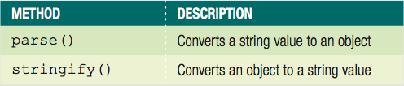
Converting Between Strings and JSON
JavaScript Object Notation (JSON)
  Represents a JavaScript object as a string
  Exchanges data between application and server
JSON object
  Supported in modern browsers, including IE8
Table 8-7 Methods of the JSON object
JavaScript, Sixth Edition

Slide 60
Converting Between Strings and JSON (cont'd.)
Converting an Object to a String
  stringify() method
  string = JSON.stringify(value [, replacer [, space]]);
  string is name of variable that will contain string
  value represents JavaScript object to be converted
JavaScript, Sixth Edition

Slide 61
Converting Between Strings and JSON (cont'd.)
Converting an Object to a String (cont'd.)
^{var newUser = {}
^{fName: "Tony",}
^{lName: "Chu"}
},
newUserString = JSON.stringify(newUser);
^{// value of newUserString is}
// '{"fName":"Tony","lName":"Chu"}'
JavaScript, Sixth Edition

Slide 62
Converting Between Strings and JSON (cont'd.)
Converting a String to an Object
  parse() method
  object = JSON.parse(string [, function]);
  object is namve of variable that will contain object
  string represents JSON string to be converted
JavaScript, Sixth Edition

Slide 63
Converting Between Strings and JSON (cont'd.)
Converting a String to an Object (cont'd.)
  JSON string definition:
    String because enclosed in quotes
  To convert string to JavaScript object:
var newUser = '{"fName":"Tony","lName":"Chu"}';
var newUserObject = JSON.parse(newUser);
^{// value of newUserObject is}
// {
^{// fName: "Tony",}
^{// lName: "Chu"}
// };
JavaScript, Sixth Edition

Slide 64
Summary
Parsing
  Act of extracting characters or substrings from a larger string
All literal strings and string variables in JavaScript
  Represented by the String class
fromCharCode() method of the String class
  Constructs a text string from Unicode character codes
toLowerCase() and toUpperCase() methods
  Change the case of letters in a string
JavaScript, Sixth Edition

Slide 65
Summary (cont’d.)
String class
  length property
  Methods: replace(), concat(), localeCompare()
Regular expressions
  Patterns used for matching and manipulating strings according to specified rules
RegExp object
  Contains methods and properties for working with regular expressions in JavaScript
JavaScript, Sixth Edition

Slide 66
Summary (cont’d.)
Use the Array class methods and length property to manipulate arrays in scripts
  Methods: slice(), shift() and unshift(), pop() and push(), splice(), sort(), reverse(), concat(), and join()
split() method of the String class
  Splits a string into an indexed array
join() method of the Array class
  Combines array elements into a string
JavaScript, Sixth Edition

Slide 67
Summary (cont’d.)
Use the JSON class methods to convert between string values and object values
stringify() method of the JSON class
  Converts JavaScript object to JSON string
parse() method of the JSON class
  Converts JSON string to JavaScript object
JavaScript, Sixth Edition

